Slide 1
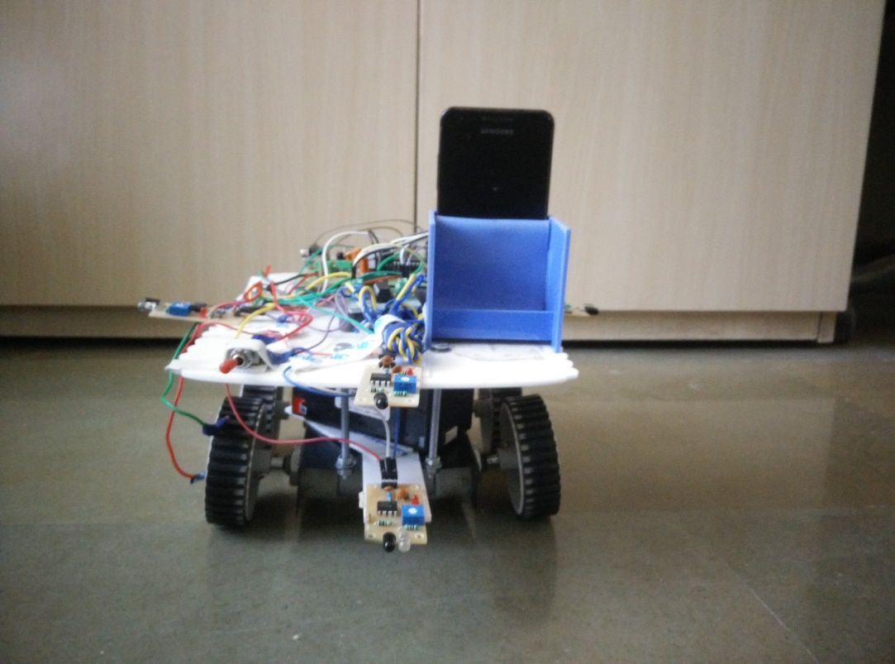


22 Shruti Synthesizer in Scilab Deep C. Patel, Maunil Vyas, Shreyas Patel Instructor :- Prof. Ashok Ranade Project executed during : Monsoon 2015
IET
INSTITUTE OF ENGINEERING & TECHNOLOGY
￼
Introduction
The usual electronic synthesizer uses 12 notes in an octave. However, Indian classical musicians use 22 ‘Shruti’ (Notes) in an Octave.
With this in view, a prototype synthesizer for 22 Shruti has been tested using Scilab interpreter.
Project Layout
User Interface
Selection of note
Selection of ‘Saptak’
Processing
Generation of notes
Assignment of notes
Sound Generation
Generated notes will be played on by pressing respective key.
Selection of scale
Results
Successfully generated twenty two Shruti with Scilab Interpreter.
Future Work
Design and develop embedded based standalone 22 Shruti Synthesizer.

Slide 2
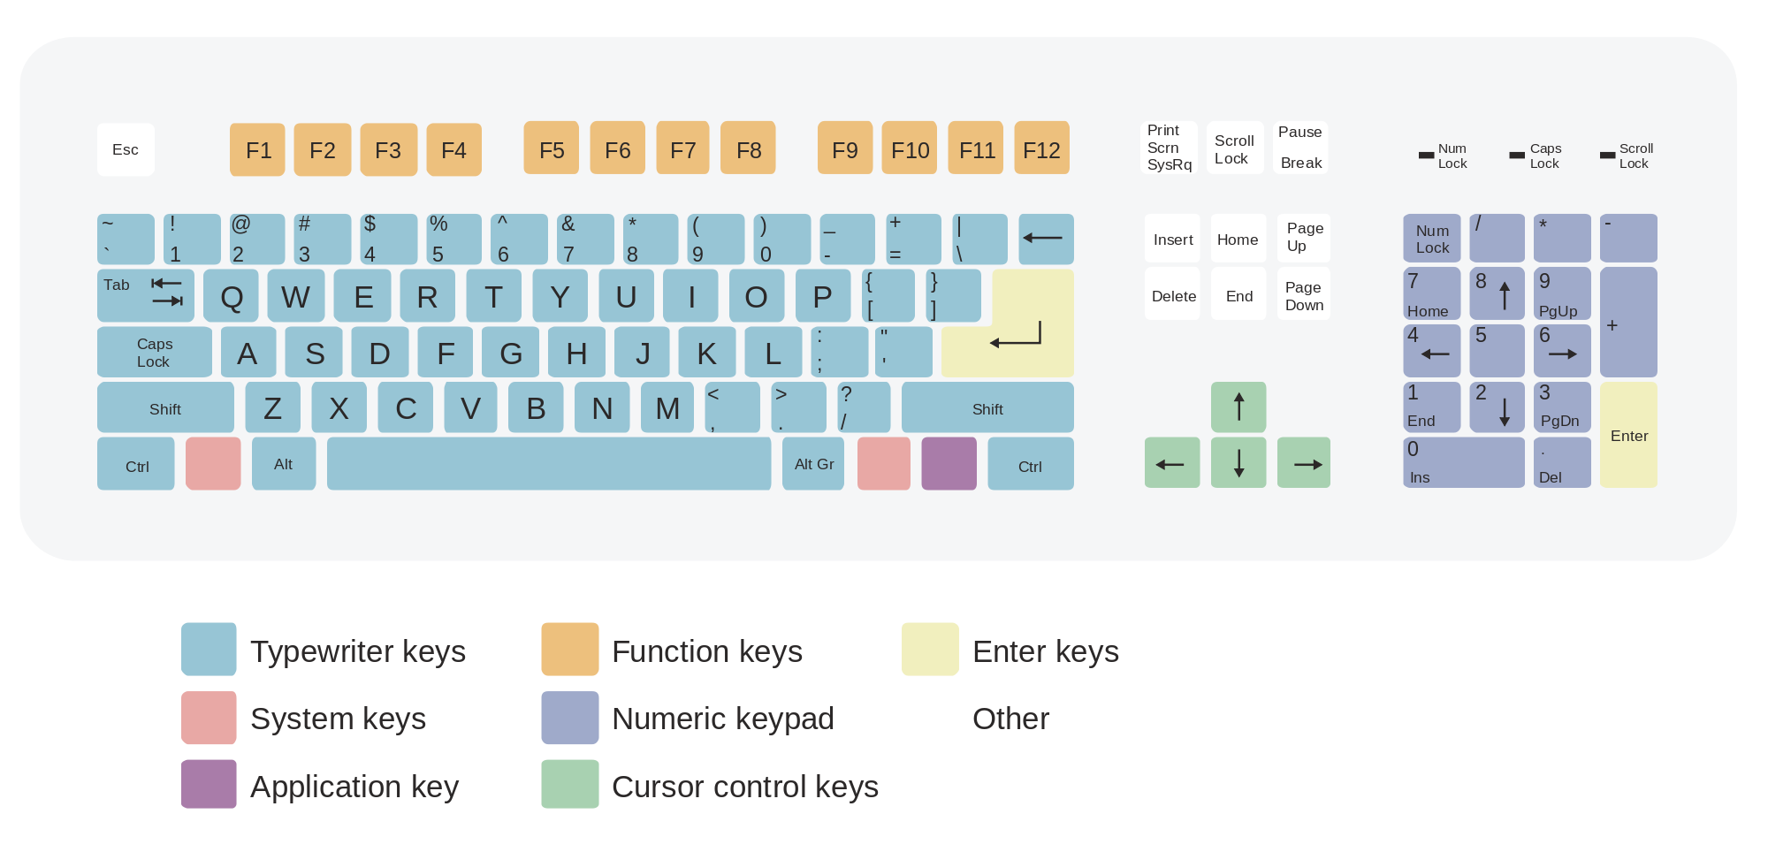
Ati komal Re
Ati
komal Ga
Ek shruti Ma
Ati komal Dh
Ati komal Ni
Re
Ga
Dh
Ni
Sa
Sa
Ma
P

Slide 3
Tones
1 - Harmonium
2 - Piano
3 - Harp
4 - Syn - Str1
5 - Strings 3
6 - Violin
7 - Flute
8 - Alto Sax
9 - Str.Guitar
10 - Vibration Pad
11 - Brass
12 - SynLead 3
13 - Bandneon
14 - Acous Guitar
15 - Jazz Guitar
16 - Electric Guitar
17 - Mute Guitar
18 - Dist Guitar
19 - Wood bass
20 - Banjo
21 - Voice Ooh
22 - Syn lead 2

Slide 4
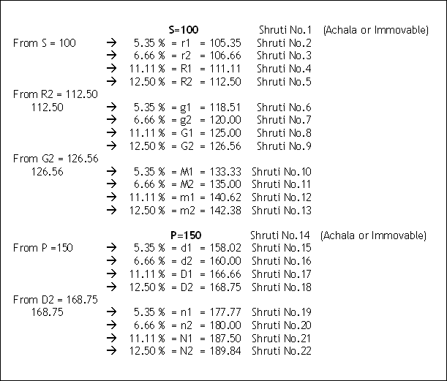
22 Shrutis Relation

Slide 5
The Main Difference in Indian Classical music and Western music is the number of notes they are using in their octaves
Western Music
Has 12 Notes in Octave
Indian Classical
Has 22 Notes in Octave

Slide 6
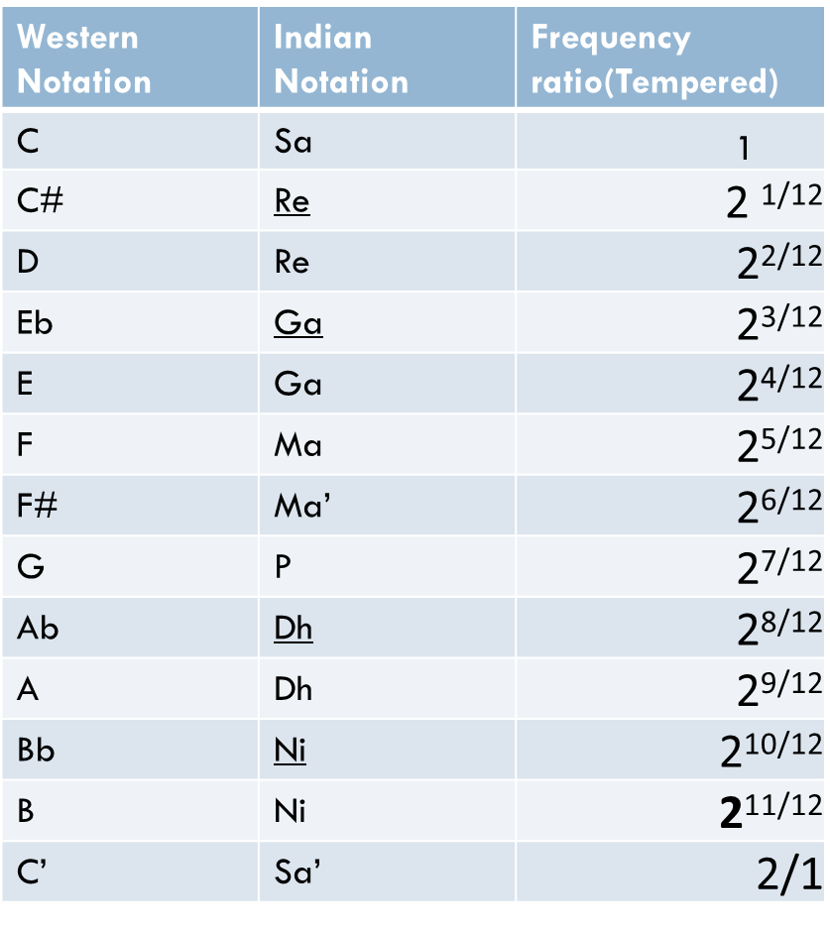
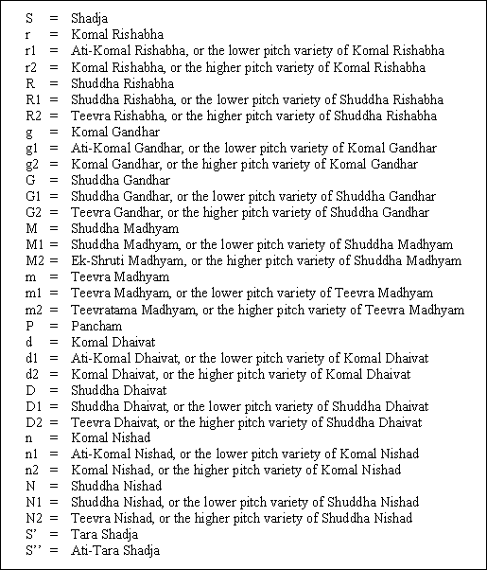
Western Music
Indian Classical Music

